Slide 1
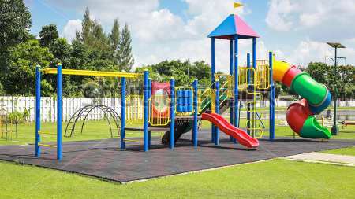
Playground Adventures!
Alfred Avor
Meagan Gallagher
Jane Claire Remick
Cyrus Voss

Slide 2

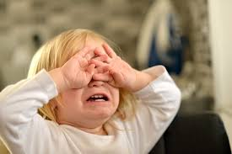

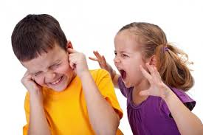
The Motivation
To take moments like these….

Slide 3
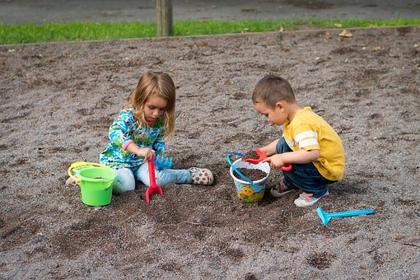
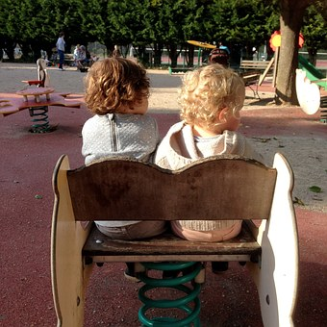

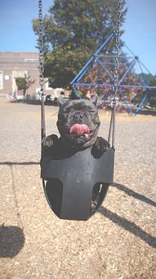
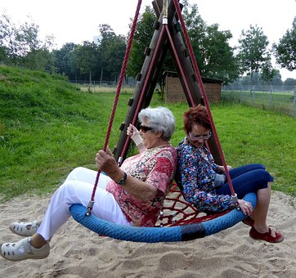
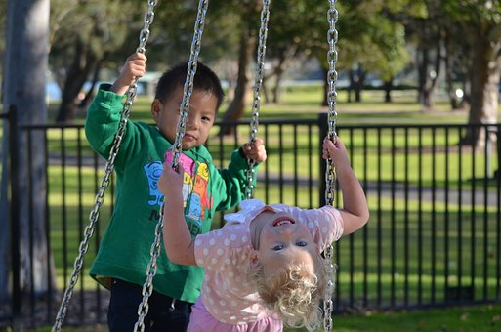
And create memories like these……

Slide 4

The Design
Key Questions
Key Features
Can it be used “on-the-go”?
Is the information provided fast, easily and conveniently to obtain and make a quick decision?
Mobile responsiveness
Location and weather specific to address or zip-code
Information provided:
Weather
Address
Information overview with accessibility

Slide 5
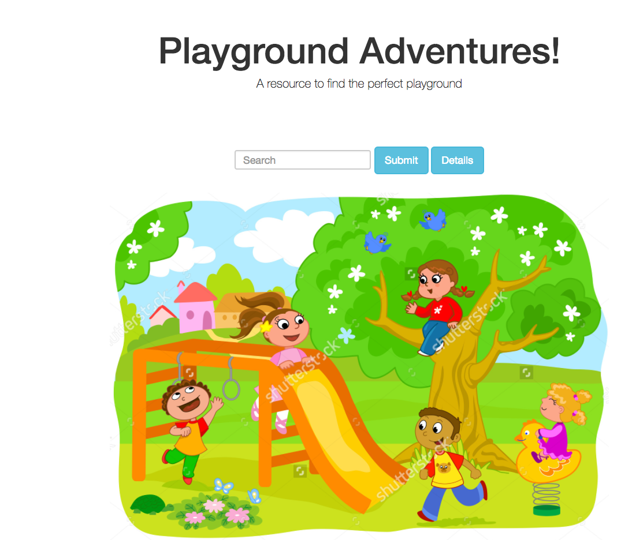
The Functionality
Features Technology:
Mobile responsiveness
Custom CSS/Bootstrap
Location search box
Google Maps API
Open Weather API
Firebase

Slide 6

The Future
Increase the data provided.
Nearby kid-friendly restaurants, attractions and entertainment venues
Fun facts about the area
Safety and health inspection reports on playground facilities (if provided)]
Increase location specific information
Enhance the user-experience
Create a form for reviews
Login and membership requirements

Slide 7


